Slide 1
Inductors and AC
Head dizzy, brain oscillate

Slide 2
Units
Voltage (V): Volts (V) Current (I): Amperes (I) Resistance (R): Ohms (Ω)
Capacitance (C): Farads (F) Inductance (L): Henrys (H) Magnetic flux (Φ): Webers (Wb)
Angular speed (ω): Radians/Second (1/s) Reactance (X): Ohms (Ω) Inductance (Z): Ohms (Ω)

Slide 3
All circuit components

Slide 4
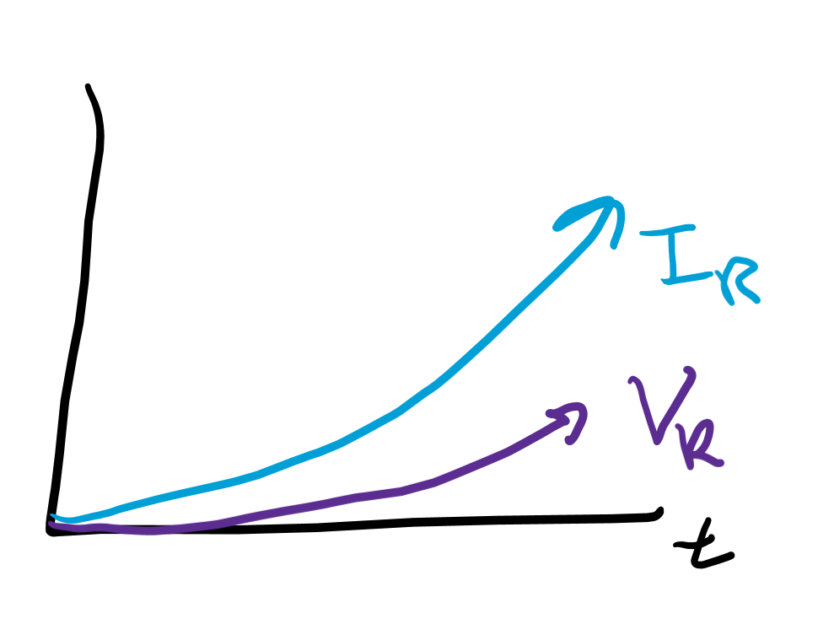
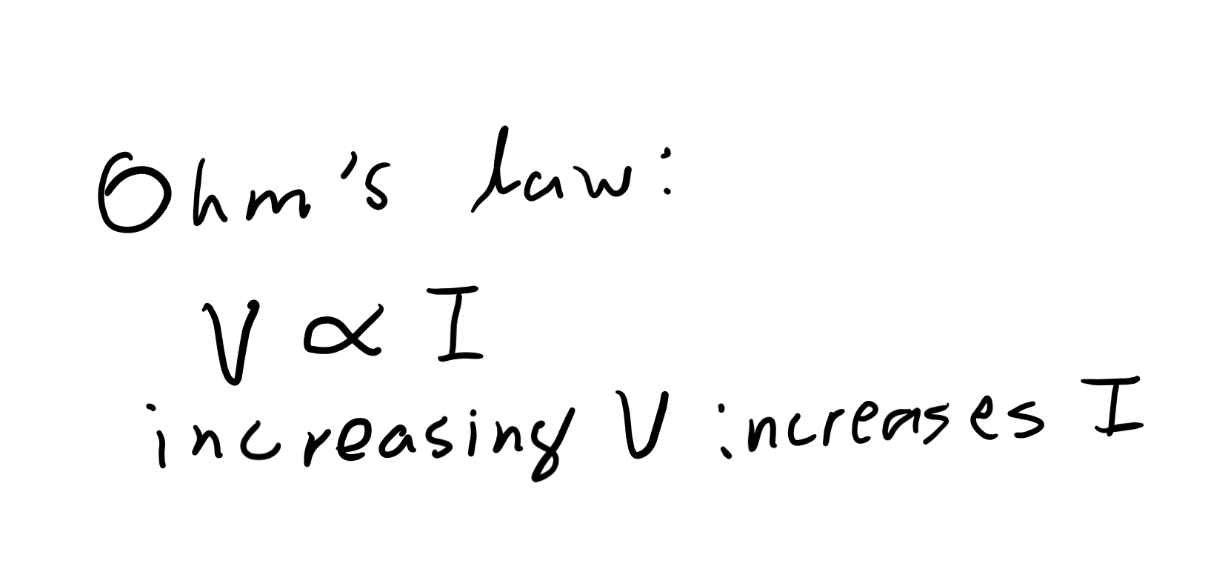
Resistors
When current hits a resistor, a voltage is generated. There is no delay from when the current hits the resistor and when a voltage is generated.

Slide 5
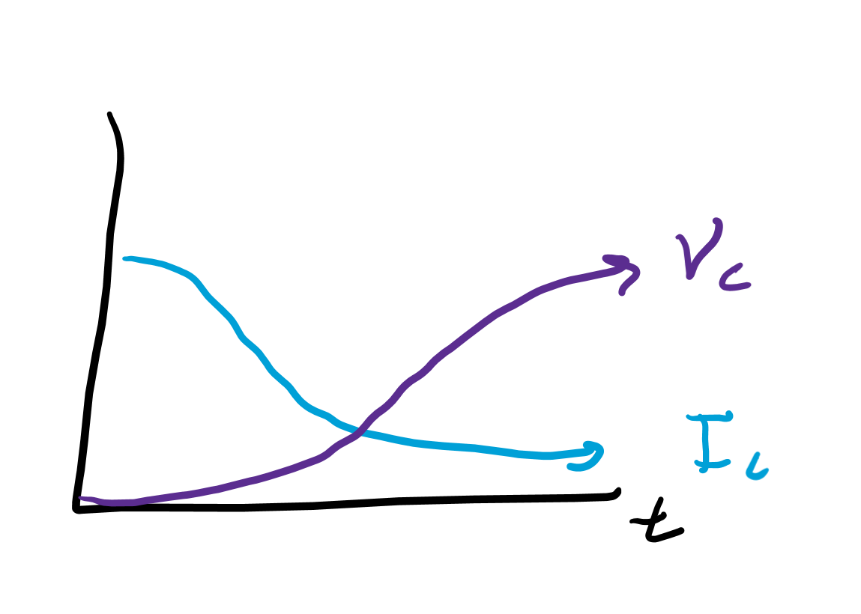
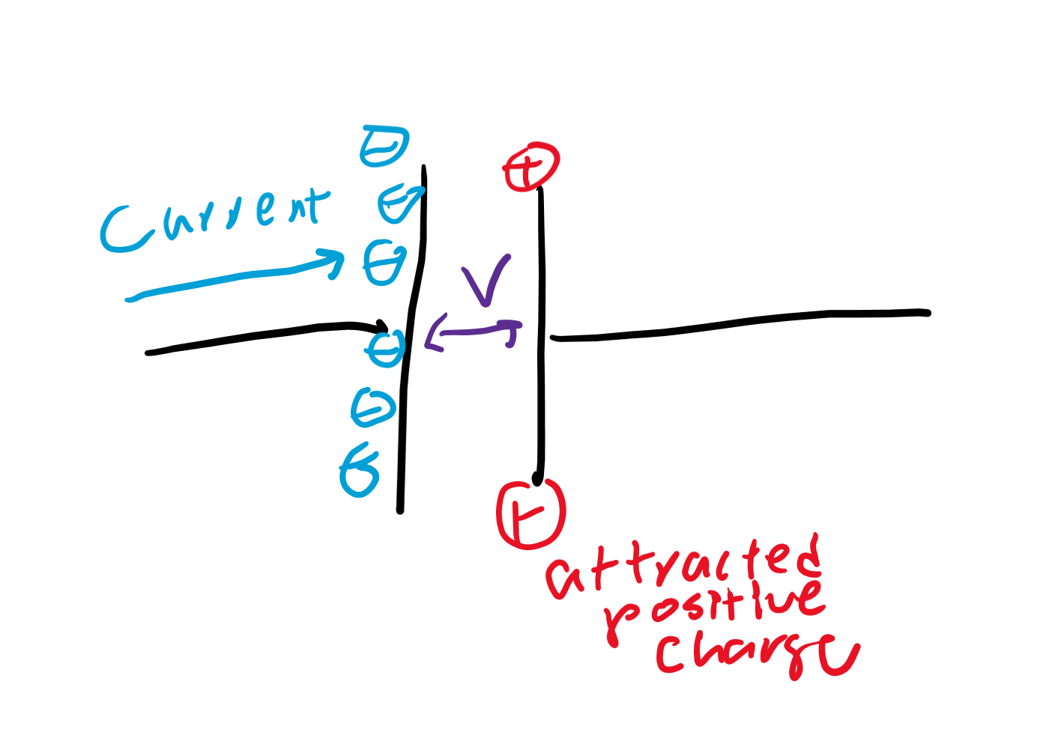
Capacitors
Current flows through the capacitor. After a little delay, the voltage slowly builds up, and the current stops flowing through the capacitor.

Slide 6
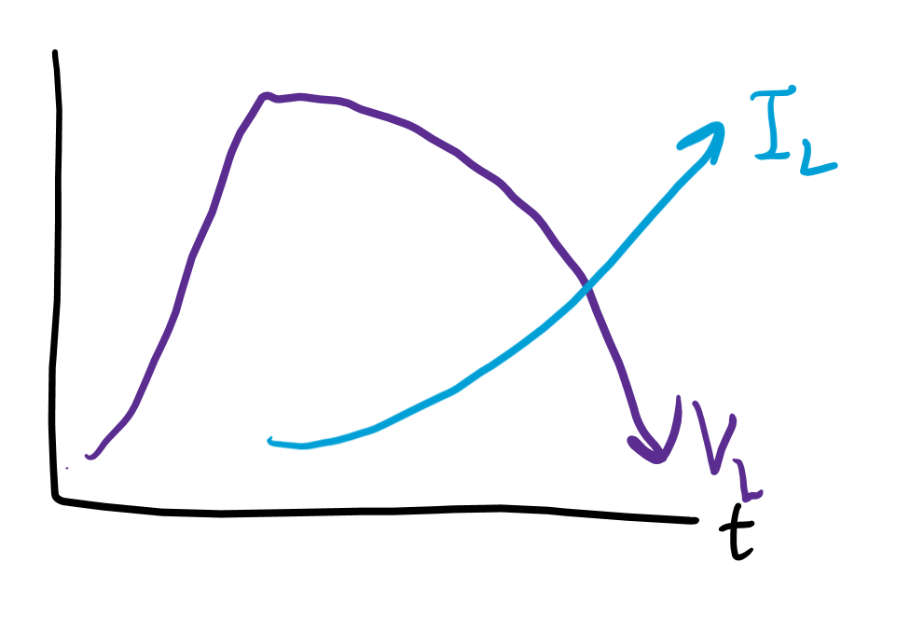
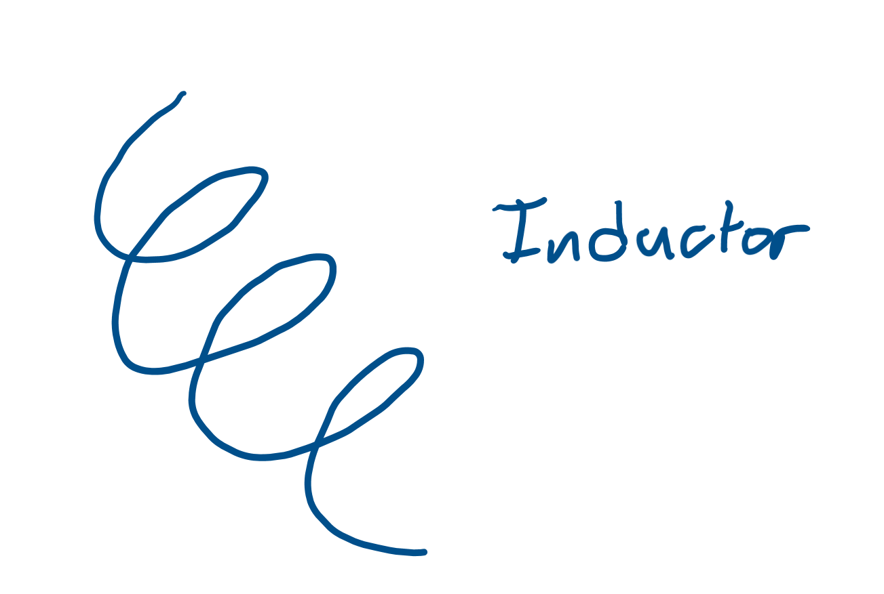
Inductors
Inductors have very high resistance, so current does not flow through it. Rather, a voltage builds up. After a little delay, since I = V/R, the current is strong enough to flow through the inductor.

Slide 7
Induction

Slide 8
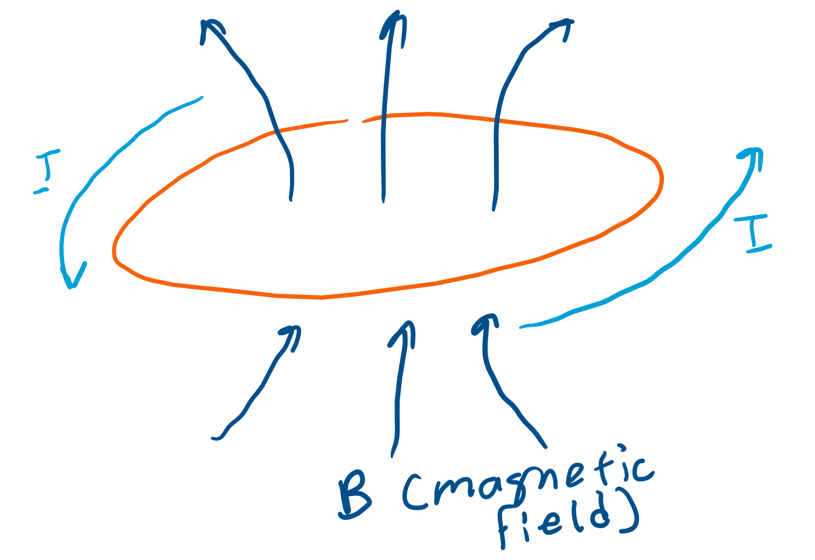
Electric current can induce a magnetic field
When current flows in a loop, a magnetic field can be generated.
This idea is fundamental behind electromagnetism.

Slide 9
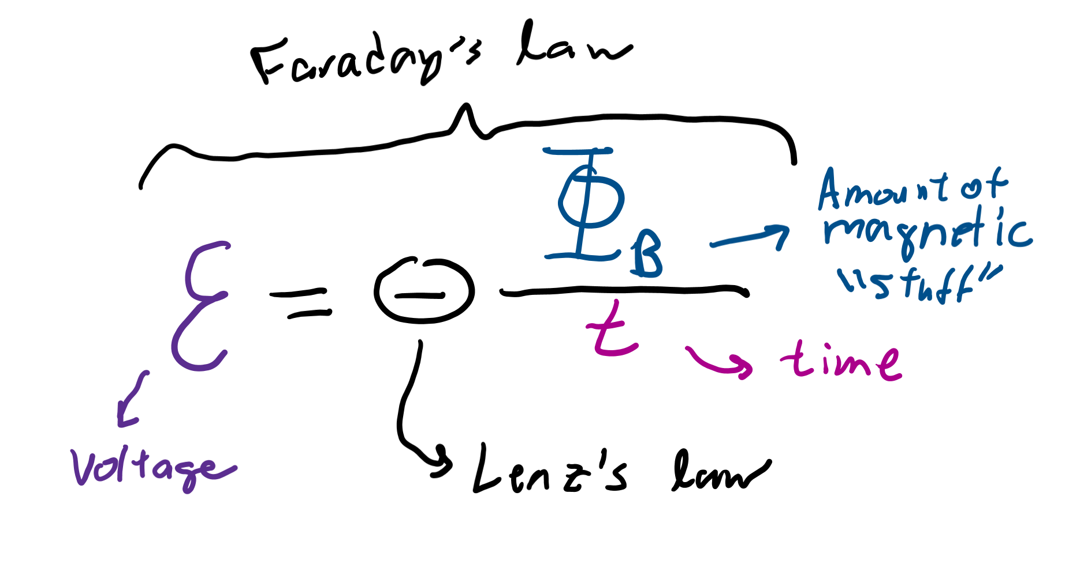
Faraday’s (and Lenz’s) law
An EMF induces a magnetic field, and a changing magnetic field induces an EMF. This idea is Faraday’s law.
The EMF opposes the change in magnetic flux and or the current. This idea is Lenz’s law.

Slide 10
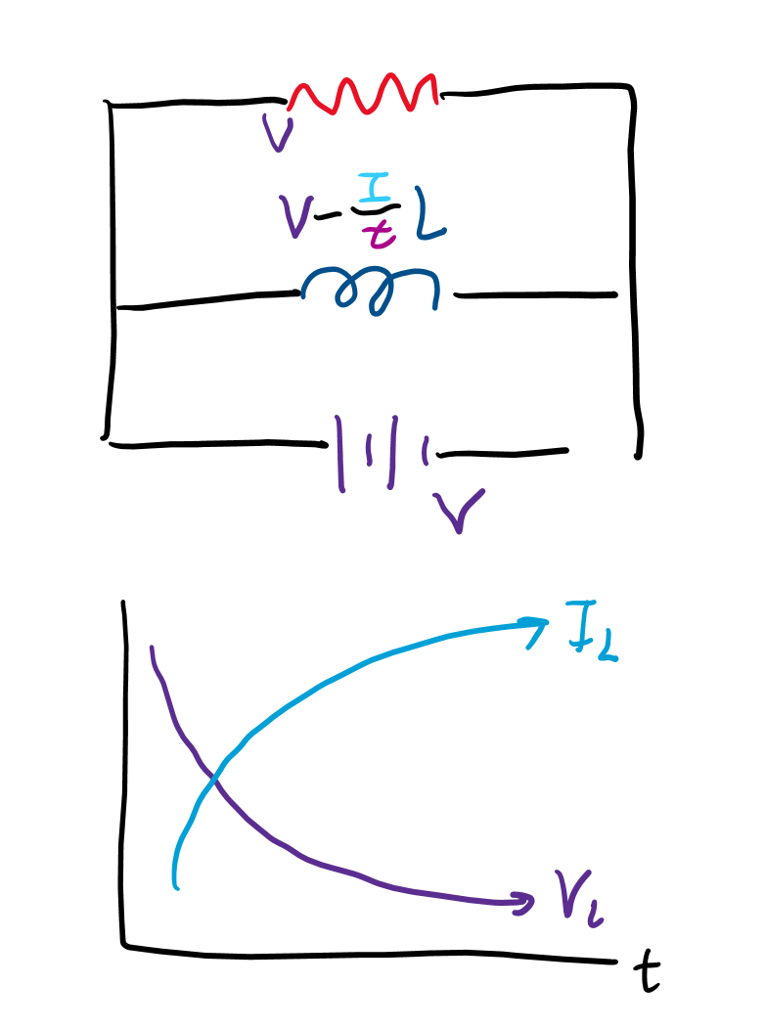
Inductors
Voltage (EMF) on an inductor is measured as “inductance” times the change in current (the EMF opposes change in current).
Since EMF = -L(I/t), total voltage decreases as current increases. That means as the voltage drops to zero, the current increases by less and less.

Slide 11
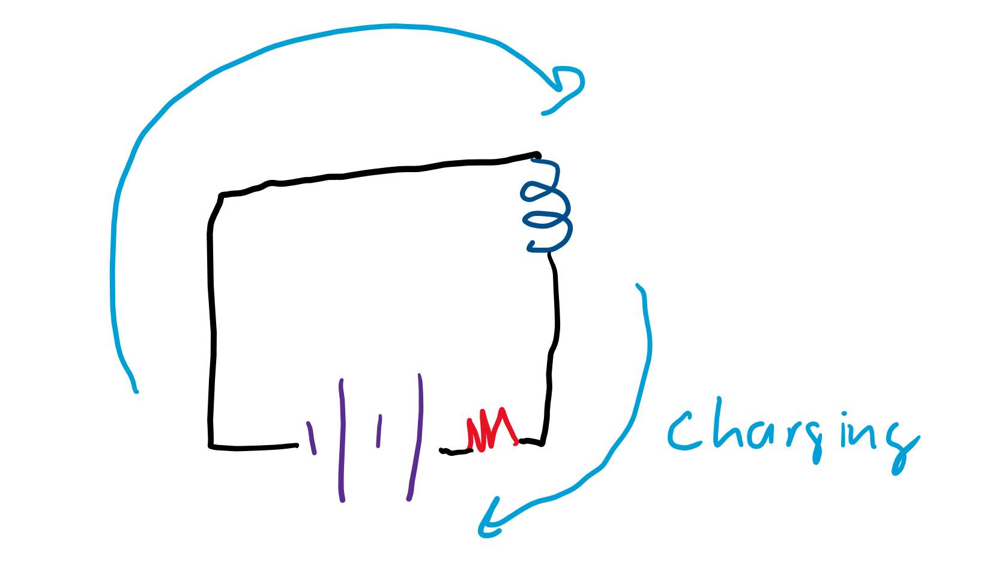
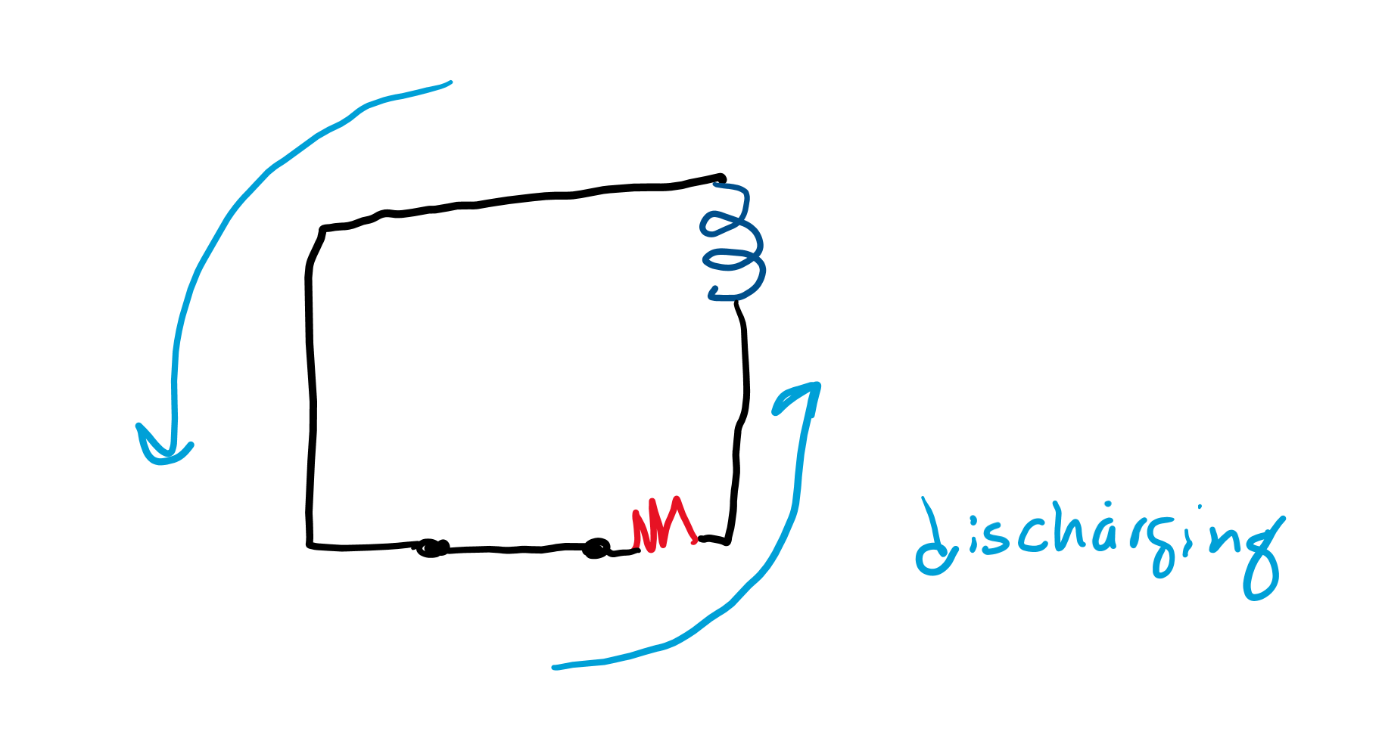
Discharging an inductor
Like a capacitor, the current will go in the opposite direction when discharging.

Slide 12
Reactance

Slide 13
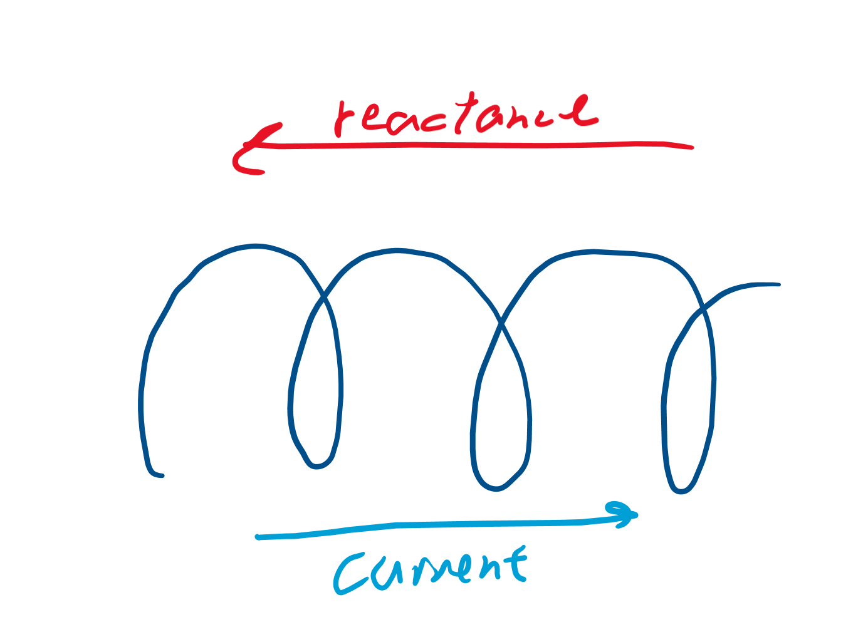
Where does the resistance go?
An inductor impedes current really well at first, but suddenly that impedance lowers. The part that “disappears” when an inductor starts moving is called “reactance.”

Slide 14
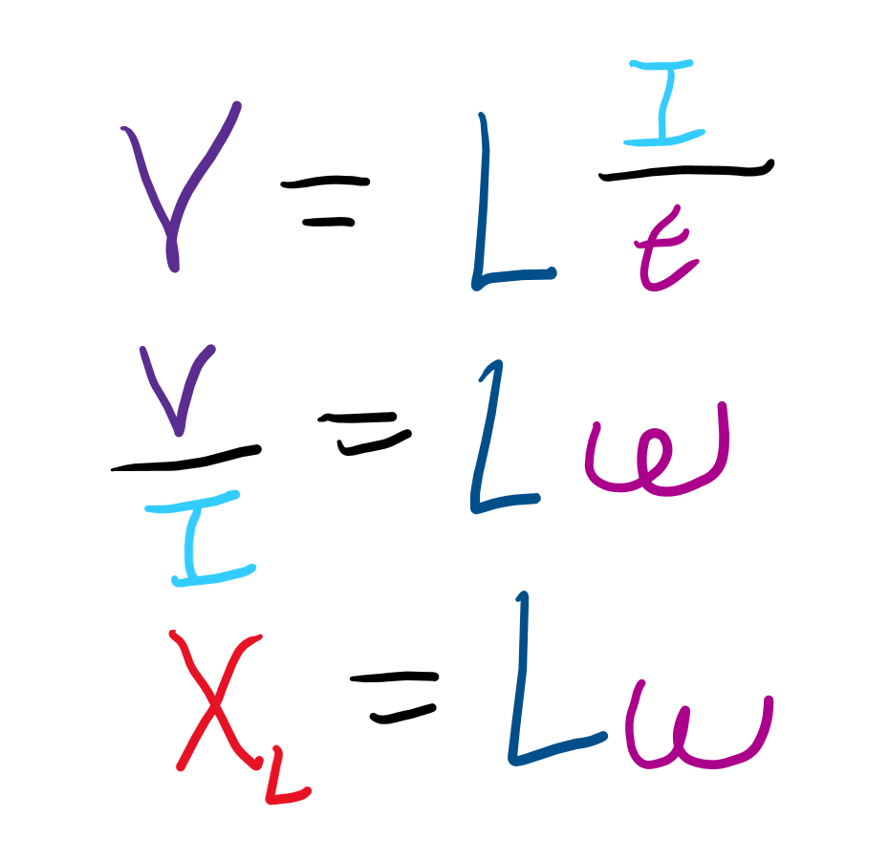
Inductive reactance
The faster current moves, the larger the EMF that opposes the current becomes, and the harder it is to charge an inductor.
The faster current moves, the larger the EMF that opposes the current becomes, and the harder it is to charge an inductor.
X_{L} (reactance) = Lω

Slide 15
LC circuits

Slide 16
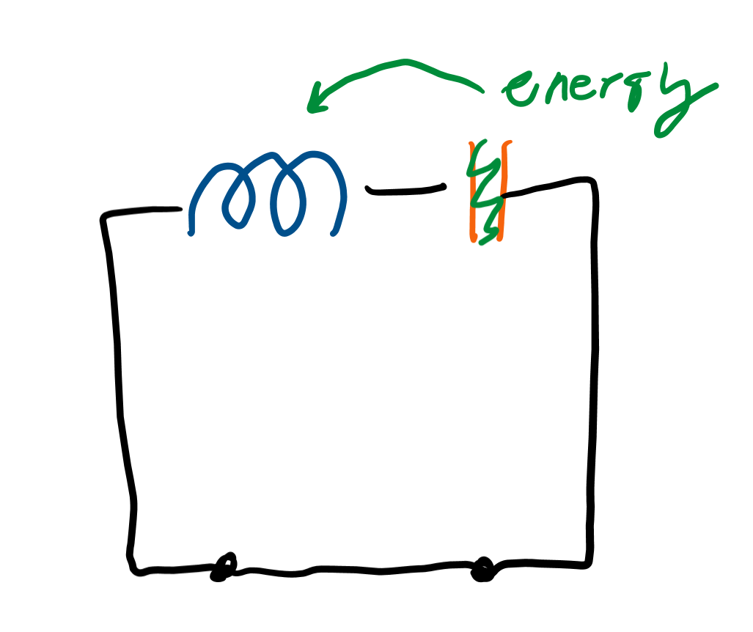
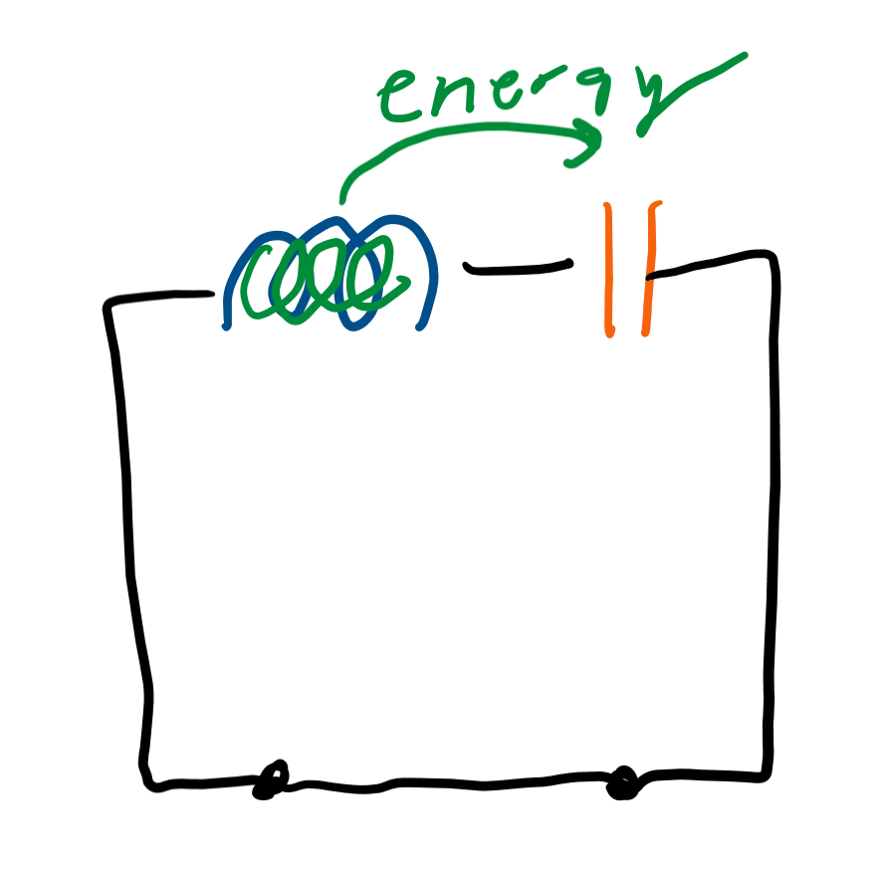
Start with L and C
Let’s start by putting all the energy on the capacitor. What will happen after a long time to the energy on the capacitor?
The capacitor should discharge energy into the inductor.
After a long time and the inductor is fully charged, what will happen to the energy on the inductor?

Slide 17
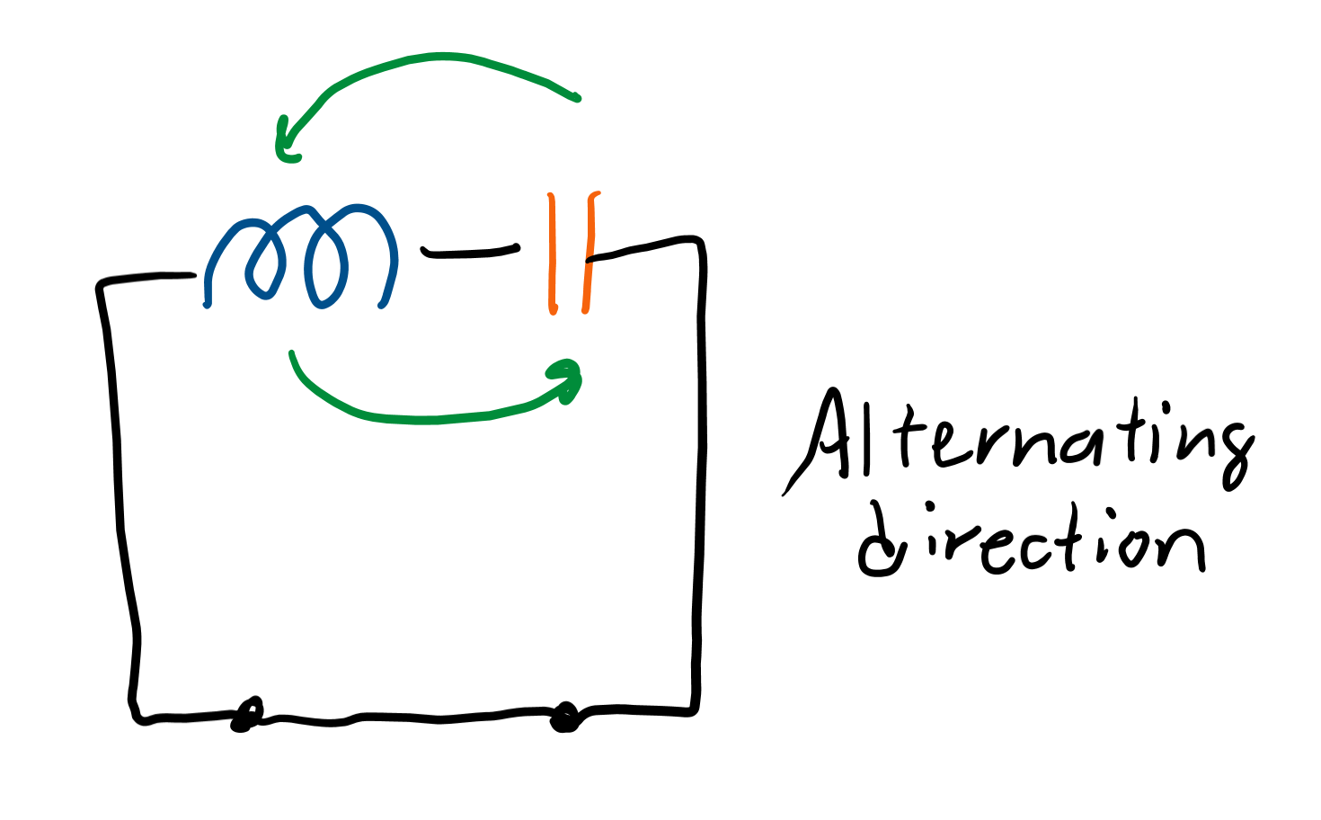
Oscillatory motion
We see that the current alternates from the capacitor to the inductor. This is called “alternating current.”

Slide 18
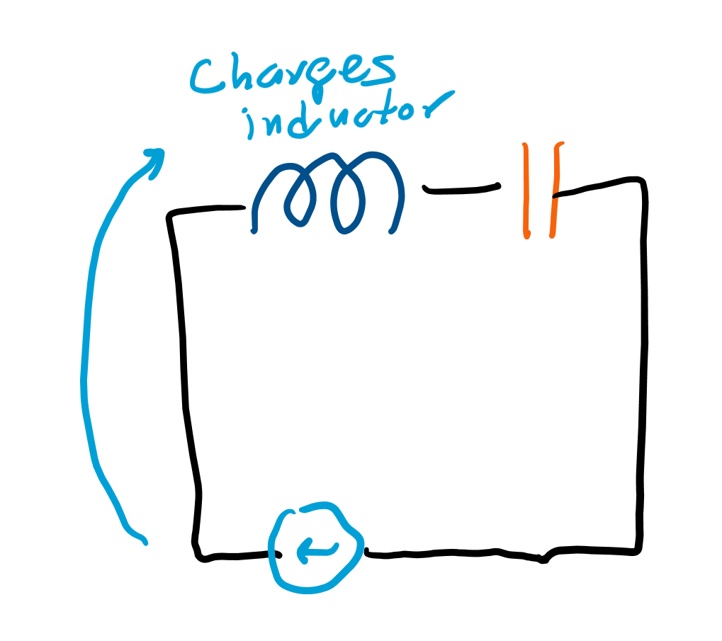
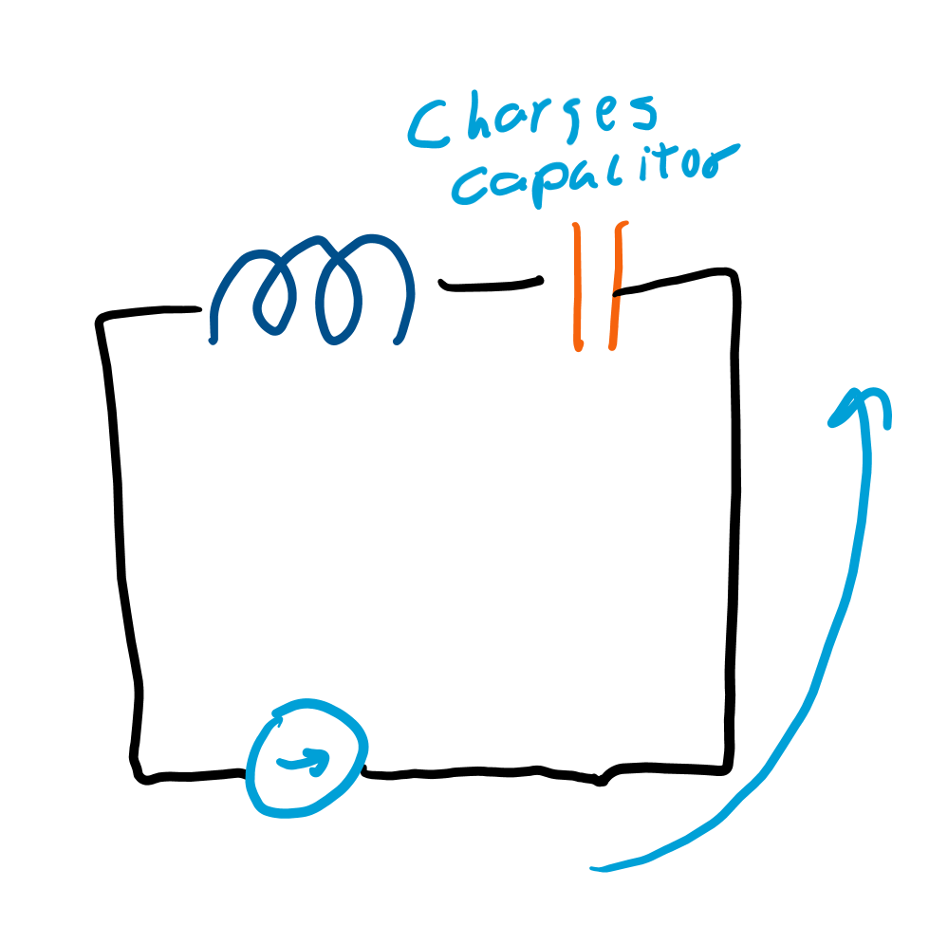
Introducing an alternating current source
Let’s say that when the inductor is charging, we add energy to the inductor, and when the capacitor is charging, we add energy to the capacitor.
This requires us to alternate the direction we provide energy, but if we do it perfectly, we can increase the total amount of energy in the system.

Slide 19
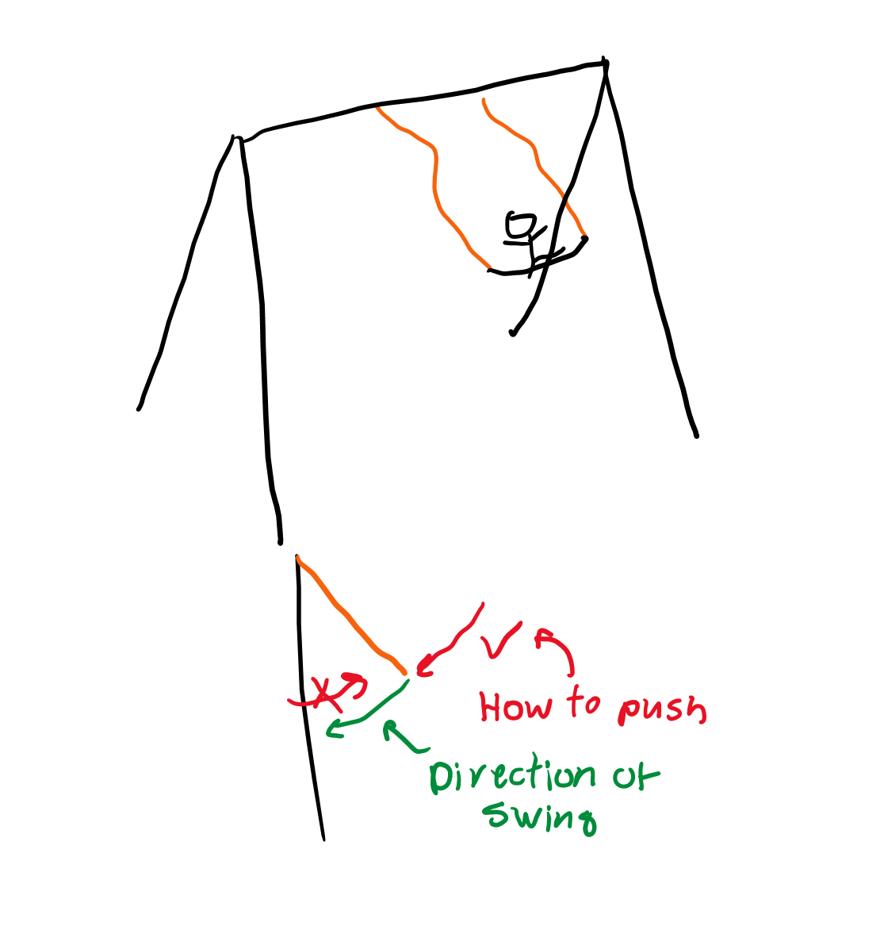
AC source out of phase
What if we do it not perfectly? Then we’re not charging it perfectly. Imagine we’re pushing a swing. If we push the swing in the wrong direction, we lose energy! Charging the inductor while the capacitor is gaining energy is pushing the swing in the wrong direction.

Slide 20
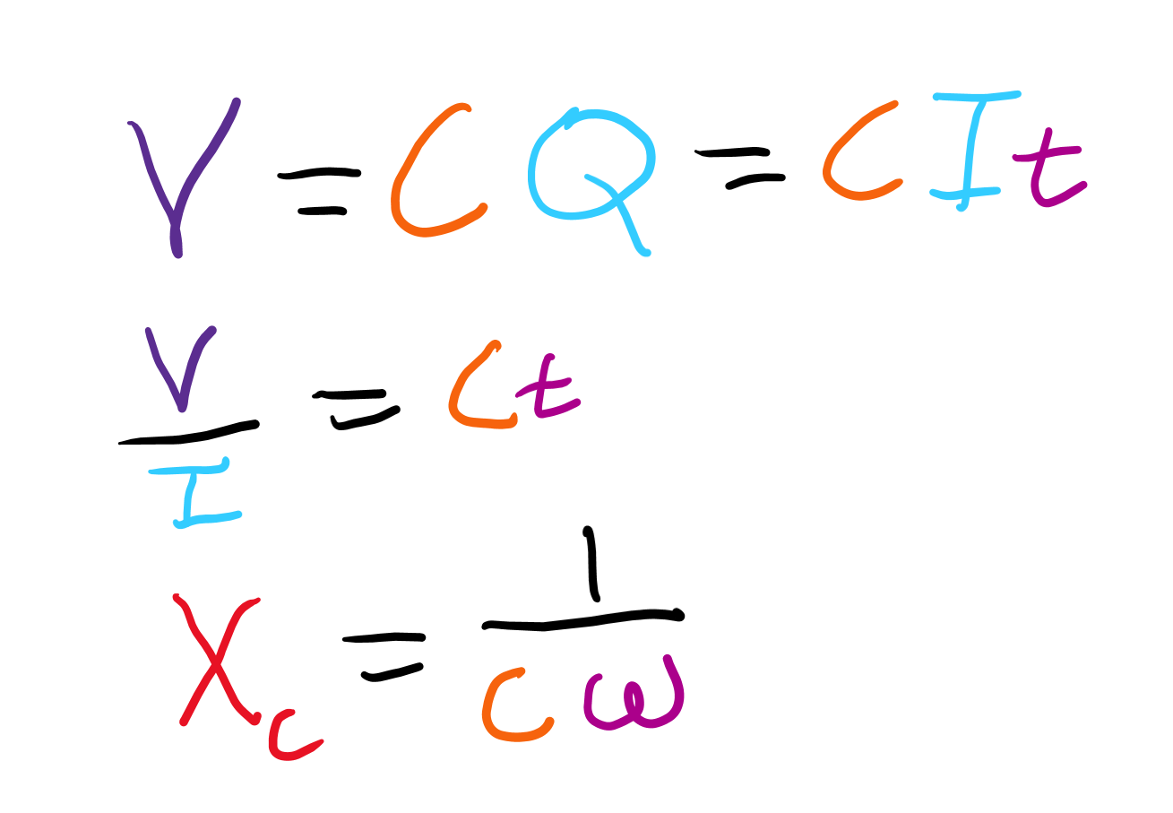
Capacitive reactance
When we’re charging the capacitor, we actually have reactance since we use a current to induce a voltage.
The equation for this is X_{C} = 1/(Cω)
Note that when the change in voltage is instantaneous (no inductor), no reactance exists.

Slide 21
Impedance

Slide 22
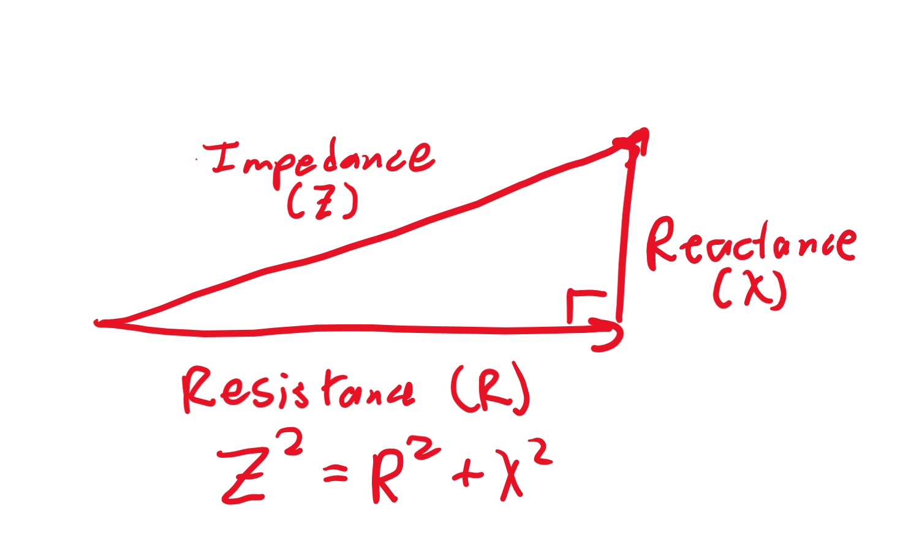
Resistance and reactance
Resistance and reactance behave differently, with reactance being “perpendicular” to resistance.
Reactance, resistance, and the “hypotenuse” of the right triangle, impedance, have the relationship where impedance (Z) squared is resistance squared plus reactance squared.

